Slide 1
Physical Modeling: Aircraft Electrical Power Network
David Meissner, Application Engineer

Slide 2
Key Messages
SimPowerSystems can do that stuff you want to do
Circuit Analysis
THD
Logic, Source Selection
Protection: over/under voltage, phase imbalance
Controls
Verification and Validation
I’m going to show a few things, but there’s a lot more
Afterwards, watch this webinar
Aircraft Power Network Development with Model Based Design

Slide 3
Stem Accelerates Development of
Power Electronics Control Systems with
Model-Based Design
Challenge
Speed the development and certification
of a power electronics control system for a
distributed power storage system
Solution
Use Model-Based Design with MATLAB and Simulink to run simulations of power electronics, the electrical grid, and controller; generate production microcontroller code; and achieve certification
Results
Six months of development time saved
Thousands of dollars in board spin costs saved
System fully operational days after hardware becomes available
A commercial installation of Stem’s PowerStore energy system.
“With Model-Based Design we saw exactly how our controller would work with the hardware even while the hardware was being developed. After we had the hardware, refinements were easy because the simulations matched what we saw on the scope, and that gave us tremendous confidence in the design.”
David Erhart
Stem
Link to user story
Notes:
Industries: Energy production, Industrial automation and machinery
Application Areas: Control systems, Embedded systems
Capabilities: Mathematical modeling, Algorithm development, System design and simulation, Embedded code generation
Products Used: MATLAB, Simulink, Control System Toolbox, Embedded Coder, SimPowerSystems, Stateflow
Country: USA
Stem Accelerates Development of Power Electronics Control Systems with Model-Based Design
In many areas, electricity bills for large businesses include charges for the total amount of electricity used, as well as demand charges based on peak usage. High demand for just 15 minutes can account for half the total charges on a monthly electricity bill. Stem’s distributed storage technology reduces peak loads by predicting usage patterns and deploying stored energy when needed. Recharged during off-peak hours, the batteries in Stem’s locker-sized PowerStore tower can provide up to 18 kilowatts of power on demand.
Stem designed and developed the PowerStore energy system in just 13 months using Model-Based Design with MATLAB® and Simulink®.
“We thought we were taking a development timeline risk, but hindsight has shown that Model-Based Design actually reduced risk because we could develop and debug the control system before hardware was available,” says David Erhart, VP of Engineering at Stem. “In fact, our simulations with Simulink and SimPowerSystems enabled us to make hardware design decisions. As a result, we shortened the product development cycle, completing it with just one board respin.”
Challenge
As a startup company with a small team of engineers, Stem needed to minimize time-to-market while keeping down costs for its first product. One way to achieve both objectives was to reduce board spins, which typically cost $15,000 or more each and consume weeks of the engineering schedule. To this end, Stem wanted to design and verify the control algorithms via simulation using a highly accurate plant model. The algorithms would need to control insulated gate bipolar transistors (IGBTs) that switch 24,000 times per second as they interact with the electric grid and the PowerStore batteries.
PowerStore had to be certified to the IEEE 1547 standard for interconnecting distributed resources with electric power systems and the UL 1741 standard for inverters, converters, controllers, and interconnection system equipment used with distributed energy resources. These standards include strict anti-islanding rules, which require all power-producing inverters connected to the grid to shut off within seconds after a power failure. Stem sought an approach that would enable them to streamline the certification process.
“With Model-Based Design we saw exactly how our controller would work with the hardware even while the hardware was being developed. After we had the hardware, refinements were easy because the simulations matched what we saw on the scope, and that gave us tremendous confidence in the design.”
- David Erhart, Stem
Solution
Stem engineers used Model-Based Design to accelerate the development of their flagship PowerStore product.
Working in Simulink and SimPowerSystems™, Brad Landseadel, chief power electronics engineer, and his team developed a plant model that included relays, IGBTs, inductors, DC-link capacitors, and pulse width modulators (PWMs) as well as a submodel of the electric grid.
They used Simulink and Control System Toolbox™ to model PowerStore’s advanced electronic control system, including the anti-islanding control logic. In Stateflow®, they modeled a state machine that manages faults, processes commands from a power monitor, and initiates sequences to charge or discharge batteries.
To debug and verify the control algorithm and its nine proportional-integral (PI) control loops, the team simulated the controller and the plant in Simulink. During these simulations, the team gained insights that influenced the hardware design. For example, they determined optimal inductance values and identified the need for additional relays.
The engineers generated C code from their controller model using Embedded Coder®, compiled the code in Code Composer Studio™ from Texas Instruments, and deployed it to TI’s TMS320F28335 digital signal processor.
After testing and refining the hardware and controller design, Stem began the certification process. During certification testing, the team created Simulink simulations to replicate tests not passed by their initial design.
“We updated the controller model, re-generated code, and passed the tests the following day,” says Erhart. “That capability got us through certification on our first try and at a pace about 25% faster than normal.”
Stem achieved UL 1741 and IEEE 1547 certifications from TÜV for the PowerStore system, which is now in production.
Results
■ Six months of development time saved. “The code we generated with Embedded Coder does just what it is supposed to do,” says Landseadel. “Writing code with nine PI loops in it by hand and then debugging it on hardware would have added six months or more to the schedule.”
■ Thousands of dollars in board spin costs saved. “Many companies require seven or more board respins. For our eight-layer board, a single respin costs about $25,000,” says Erhart. “With Model-Based Design, we needed just one respin before production. That saved time and potentially hundreds of thousands of dollars, which for an early-stage company is substantial.”
■ System fully operational days after hardware becomes available. “Model-Based Design enabled us to develop the controller software before we had hardware,” says Landseadel. “When our first boards came in, all the control algorithms were already in place; five days later we were delivering power with code generated by Embedded Coder.”
Learn more about Stem: www.stem.com

Slide 4

GasTOPS Develops and Tests Propulsion Control Algorithms for the USS Makin Island
Challenge
Develop the propulsion control algorithms for the USS Makin Island
Solution
Use Model-Based Design with MATLAB and Simulink to model the ship’s main systems, develop and verify control algorithms, and generate code for onboard training and HIL test setups
Results
Time-to-simulation cut by two-thirds
Key design issues identified early
Models reused multiple times
The USS Makin Island.
“We mitigate risk by simulating complex marine and aircraft systems before they are built. To reduce costs, we automate simulations with MATLAB and reuse models throughout development. Understanding
multidomain systems through simulations in Simulink and SimPowerSystems is invaluable to our business.”
Shaun Horning GasTOPS
Link to user story
Notes:
Industries: Aerospace and defense
Application Areas: Control systems
Capabilities: Data analysis, Mathematical modeling, Algorithm development, System design and simulation, Physical modeling, Embedded code generation
Products Used: MATLAB, Simulink, SimPowerSystems, Simulink Coder, Stateflow
Country: USA
GasTOPS Develops and Tests Propulsion Control Algorithms for the USS Makin Island
The USS Makin Island (LHD 8) is a twin-shaft amphibious assault ship in active service with the U.S. Navy. Nearly 850 feet long and with a full displacement of over 40,000 tons, the Makin Island can carry and launch dozens of helicopters and landing craft. Unlike earlier steam-powered ships of its class, the Makin Island uses a hybrid-electric propulsion system with gas turbines for high-speed travel and electric motors for efficient low-speed operation. The new propulsion configuration has two 35,000 BHP gas turbines, two 5000 BHP AC electric motors, and six diesel generators.
GasTOPS used Model-Based Design with MATLAB® and Simulink® to model the LHD 8 propulsion plant and develop its control algorithms, simulate the electrical power generation and distribution system, and create a simulator-stimulator system for real-time hardware-in-the-loop (HIL) testing of the machinery control system. This approach enabled the team to identify potential problems before sea trials began.
“With MATLAB and Simulink, we can rectify issues early in the design phase,” says Shaun Horning, vice president of Technical & Engineering Services at GasTOPS. “Before the ship is built, we can analyze crash astern, crash ahead, and other maneuvers, and generate a set of expected results to compare with actual sea trial results.”.
The Challenge
The machinery control system (MCS) aboard the LHD 8 controls the propulsion system, including transitions between electric motor and gas turbine drive modes, as well as more than 20 other major ship systems. Altogether, the MCS has more than 10,000 input and output signals.
To develop control algorithms for the complex, first-of-its-kind propulsion system, GasTOPS needed an accurate model of the plant. Later, GasTOPS would need to run parametric studies, model electrical power generation and distribution, generate code for HIL test setups, and create a simulation engine for an onboard training system. GasTOPS required a flexible, multidomain modeling and simulation environment that supported all these activities.
“We mitigate risk by simulating complex marine and aircraft systems before they are built. To reduce costs, we automate simulations with MATLAB and reuse models throughout development. Understanding multidomain systems through simulations in Simulink and SimPowerSystems is invaluable to our business.”
- Shaun Horning, GasTOPS
The Solution
GasTOPS used Model-Based Design with MATLAB and Simulink to accelerate LHD 8 development and analysis projects. GasTOPS engineers developed a Simulink model of the propulsion system, including submodels for the hull, propellers, shafting, gearboxes, motors, generators, and gas turbines.
Many of these submodels came from a Simulink library of parameterized components that GasTOPS had developed for similar projects. Others were provided by OEMs as MATLAB or Fortran code, and integrated into the Simulink propulsion model.
GasTOPS modeled the machinery control system in Simulink and Stateflow®, using state transition diagrams to describe drive mode changeovers.
The engineers conducted an extensive test program in which MATLAB scripts were used to launch Simulink and collect the results of simulated ship maneuvers under various environmental conditions. In parametric studies, sweeps of propeller efficiency, hull resistance, and other key values were conducted to assess MCS performance and robustness.
For the electrical plant, the team used Simulink and SimPowerSystems™ to model six diesel generators, eight transformers, numerous smart breakers, and the distribution system, as well as electric motors and other loads. They performed simulations to evaluate the system response to short circuits, generator failures, and various fault conditions.
GasTOPS combined elements of the propulsion and electric plant models with models of other machinery systems in Simulink, and used Simulink Coder™ to generate code for a real-time HIL testing setup. They streamlined this process by creating MATLAB functions that generate Simulink models based on predefined operating parameters for pumps, valves, fans, and other components.
Later, the team extended the MCS test model to support simulation of about 100 different system and component faults, and used Simulink Coder to generate C code for an onboard training system.
The MCS is now in service aboard the USS Makin Island.
Results
■ Time-to-simulation cut by two-thirds. “It’s not uncommon for companies to spend six months or more modeling ships and other complex systems before they get any useful simulation results,” says Horning. “Using MATLAB and Simulink with the library and scripts we have developed, we can have simulation results in two months or less, which can be a huge advantage during the design process.”
■ Key design issues identified early. “Our simulations revealed that in the transition from turbine power to electric power, the turbines provided substantially more power than was expected during their cool down,” explains Horning. “Simulink enabled us—and our clients—to understand how the systems would perform before the ship was built.”
■ Models reused multiple times. “Our propulsion and electrical system models were based on Simulink library elements,” says Horning. “We reused elements of those models extensively to verify the controller design, generate code for HIL tests, and create the core of the onboard training environment.”
Learn more about GasTOPS: www.gastops.com

Slide 5
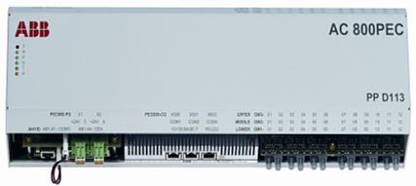
ABB Accelerates Application Control Software Development for Power Electronic Controller
Challenge Adopt a more efficient development process using tools that accelerate the design of new application software for a high-powered electronic controller for power converters
Solution
Use MathWorks tools to design and validate their control algorithms while streamlining the application software development process for the controller
Results
Development times and costs reduced
Development process improved
Highly accurate code generated
AC 800PEC controller.
“Our system engineers can program, simulate, and verify the AC 800PEC controller’s regulation software very rapidly in MATLAB and Simulink.”
Fritz Wittwer ABB
Link to user story
Notes:
Primary Industry: Industrial Automation and Machinery
Secondary Industries: Energy Production
Application Areas: Automatic Code Generation, Control Design, Simulation
Products Used: MATLAB, Simulink, MATLAB Coder, SimPowerSystems, Simulink Coder, Stateflow
Country: Switzerland
ABB Accelerates Application Control Software Development for a Power Electronic Controller
Switzerland-based ABB develops technologies that enable utility companies in more than 100 countries to improve performance while reducing environmental impact. ABB’s Power Electronics group recently launched the AC 800PEC, a high-end power electronic controller for power converters. Combining a powerful CPU with a large FPGA, the AC 800PEC controls high-power rectifiers, frequency converters for microturbines, wind turbines, traction drives, battery energy storage systems, and other power electronic applications.
ABB improved productivity by optimizing their control software development process using MathWorks tools to design and automatically generate code for the control software in the AC 800PEC controller.
“MathWorks products considerably reduced development time for application software for the new controller,” says Fritz Wittwer, head of system development, R&D power electronics at ABB. “These economies of time have resulted in significantly lower costs and time to market.”
Challenge
On previous projects, the ABB team used a traditional development process in which system engineers defined specifications and software engineers then wrote the software based on their interpretation of these specifications. This process was time-consuming and error-prone. It also reduced the likelihood that the software would correspond to the original specifications and concept.
The ABB development team sought a development process that would avoid these difficulties while increasing productivity.
“Our system engineers can program, simulate, and verify the AC 800PEC controller’s regulation software very rapidly in MATLAB and Simulink. This approach markedly reduces development times and produces significantly fewer deviations from the specifications.”
Fritz Wittwer, ABB
Solution
MathWorks tools for Model-Based Design provided ABB with a single development platform for the entire development process, which they call Optimized Process of Control Development.
ABB had used Simulink® to run system simulations for other projects. As a subscriber to Software Maintenance Service (SMS) they added Simulink Coder™ to their development environment for the new power electronic controller. They use Simulink Coder to automatically generate and download controller code from their Simulink models to the AC 800PEC controller, eliminating the need to translate the models manually into C code.
They use MATLAB® and Simulink to design the control algorithms for filtering, current control, grid synchronization, and grid power monitoring, and to calculate power, idle power, and other physical variables.
Engineers use SimPowerSystems™ to validate the algorithms by running system simulations. Stateflow® enables ABB to model control sequences and ensure fast fault protection.
Using Simulink Coder, they generate ANSI C code automatically from their Simulink models. They also use Simulink Coder to generate C code from their Stateflow charts, thereby avoiding the laborious and time-consuming manual translation of the control algorithms into source code. They can use the generated code directly in the controller.
Using Simulink External Mode enables them to interactively debug the software on the controller.
ABB keeps the specification and the code synchronized throughout the development process by using Simulink models as executable specifications. Parameters can be changed and optimized on the PC, and code can be automatically generated from the models and then transferred to the controller directly via an Ethernet connection.
The AC 800PEC controller has been delivered to market for use with traction converters that have demanding hardware requirements with high temperature range and vibration.
Results
■ Development time and costs reduced. “MathWorks products considerably reduced application control software development time for the new AC 800PEC controller in comparison with the controller’s predecessor,” says Wittwer. “The code generated from the Simulink models can be used directly in the controller, eliminating the need for a separate, costly implementation phase.”
■ Development process improved. Staying subscribed to SMS enables ABB to take advantage of MathWorks twice-yearly product updates to further improve their process based on Model-Based Design. “Our largest benefit from the SMS program is the new features that product updates deliver,” says Wittwer.
■ Highly accurate code generated. Virtually 100% of the C code for the AC 800PEC controller is generated automatically by Simulink Coder. “With this approach, what you simulate is what you execute,” explains Wittwer. “The generated code is error-free and precisely describes the control algorithm defined with Simulink.”
Learn more about ABB: www.abb.com

Slide 6
Agenda
Overview of Aircraft Power Network Model
Model Based Design
Transformer Rectifier Unit
Logic and Controls
SimElectronics vs SimPowerSystems

Slide 7
Aircraft Power Network System for Analysis
Half-aircraft model
One generator
AC bus with loads
TRU (Transformer- Rectifier Unit)
DC bus with loads and battery
Breakers open and close during flight cycle
DC Bus
Batt
TRU
AC Bus
GEN
DC1
AC1
APU
DC2
AC2
GEN
DC3
AC3
External Power
Not modeled
Breaker

Slide 9
Agenda
Overview of Aircraft Power Network Model
Model Based Design
Transformer Rectifier Unit
Logic and Controls
SimElectronics vs SimPowerSystems

Slide 10
What is the Most Expensive Project Stage to Find Errors In?
Relative cost to fix an error
Errors introduced in:
coding phase
design phase
requirements phase
Requirements phase
Design phase
Coding phase
Testing phase
Project phase where error is fixed
Source: Return on Investment for Independent Verification & Validation, NASA, 2004.
Notes:
So why do we need to find errors early, why did people list it as an important challenge?
Here is a study by NASA, that answers these questions. The x-axis shows the phase where the error is found and fixed, and the y-axis shows the relative cost to fix the error.
Bar color corresponds to the project phase where the error was introduced.
[Advance]
For example the most expensive type of error to fix is an error in the requirements that is only found during testing.
It is very expensive because you will need to go through the whole development process to fix it – not only expensive, but also time-consuming.
So, finding errors early means we can develop our products cheaper and quicker, and that is why it is so important.
[Note to presenter: NASA study can be downloaded directly from http://sarpresults.ivv.nasa.gov/DownloadFile/24/10/Direct%20ROI%20of%20IV&V%20ATS2003%20presentation.ppt
The saved version of the report (powerpoint file) is also available on the ECL).]

Slide 11
Cost Savings with Model-Based Design
Total Savings | $253,200
Percent Savings | 66%
Notes:
To understand the potential savings, MathWorks has used savings calculator. Working with development organizations like yours, we’ve done a series of internal savings studies. What you see here is a representation of the savings that an organization can achieve with Model-Based Design on a project with 5,000 lines of code. Using MBD you can expect to save from 50% to 70% in development costs over the traditional development process. Your results may vary – and we’d be glad to sit with you and discuss the details of the analysis and apply it to your organization.
[Note to presenter: the numbers are based on a specific scenario with certain assumptions. More specifically, we assume a program with 5,000 lines of code, and a team of 10 people).

Slide 12
Breakdown of $253K saved
Total Savings | $253,200
Percent Savings | 66%
Notes:
Looking at the breakdown of where the savings came from, it is clear that the results came in verifying the requirements (or the specifications) and in reducing the cost of error re-work in the testing phase (removing latent errors). These results show quite clearly the savings from doing early verification with Model-Based Design.
You will get some savings in the design stage because doing data analysis to understand how to revise your design is more efficient in MATLAB than in other tools.
The time that was previously spent tuning controller on the hardware is now spent on developing the models. As you get better with modeling, and as you start reusing models for other projects, the savings in design stage will get significantly higher.
We also assumed that coding is done manually, just as before, so we do not show savings here.
You are probably thinking at this point: all this sounds pretty good, but will it really work for me, my group, and my company. The answer to your question is yes, and to convince you I would like to share with you a few of success stories from our customers who adopted Model-Based Design.
[ Choose 3 relevant user stories from the following slides, describe problem and solution quickly, and iterate on the message how Model-Based Design helped the customers to do things better, cheaper, and faster.]

Slide 13

Traditional Development Process
RESEARCH
REQUIREMENTS
SPECIFICATIONS
Requirement Documents
Difficult to analyze
Difficult to manage as they change
Paper Specifications
Easy to misinterpret
Difficult to integrate with design
DESIGN
EDA
Algorithm
Design
MCAD/
MCAE
Physical Prototypes
Incomplete and expensive
Prevents rapid iteration
No system-level testing
Electrical Components
Embeddable Algorithms
Mechanical Components
Manual Coding
Time consuming
Introduces defects and variance
Difficult to reuse
IMPLEMENTATION
C/C++
Traditional Testing
Design and integration issues found late
Difficult to feed insights back into design process
Traceability
Embedded Software
INTEGRATION AND TEST
Notes:
Let’s look at a simplified representation of a traditional development to understand why it is difficult to find errors early in designing multi-domain systems.
[ Short Version ]
[Advance]
The complexity in systems is dictating more complex requirements. These more complex requirements are difficult to analyze and to manage as they change.
[Advance]
Complexity of specifications makes them easy to misinterpret. It is also difficult to trace specs to the design.
[Advance]
The controller algorithms are manually tuned on a prototype or on the actual system. Prototypes often are not easily available or let you test only part of the overall system.
[Advance]
Coding is done manually, often resulting in errors when design is not interpreted correctly.
[Advance]
And the integration and test phase is where the problems show up, since that is the first time systems are integrated. The result is that errors are found late and are expensive to fix.
[Advance]
The different tools used throughout the development process make it difficult to understand how the whole system will work and how different components will interact with each other.
If different groups are working on different parts of the projects, there is also a communication problem between them.
[Advance]
So let me introduce Model-Based Design and explain how it will help you detect errors early and therefore allow you to design innovative products with high performance faster and cheaper.
Model-Based Design is a Computer Aided Engineering (CAE) solution for MATHEMATICALLY describing how the equipment will work.
[Advance]
[Long Version]
Generally, a typical process for a project to design an embedded control system involves iterative cycles of these phases:
Specification development
Design and Implementation
Integrate and Test
[Advance]
This design approach starts with requirements and specifications which are typically text documents. With any document, interpretation is subjective to the reader, so misinterpretation of the design intent is common. In addition, engineers involved might not realize that the document is missing crucial information until the project reaches a later stage when hardware becomes available.
[Advance]
In the design and implementation stage, components for each subsystem (for example: mechanical electrical, controls, embedded software) are designed in different tools that do not necessarily facilitate system level analysis of how the different components will interact with each other, and how the product will work in the operating environment.
[Advance]
Testing occurs only when each component has been implemented and then integrated into a prototype. Prototypes are expensive and time-consuming to create – you can only make a limited number of prototypes and most likely you will take the path that ensures early success; typically a modest variation of previous products. To be clear, physical prototyping is ALWAYS required, however, physical prototyping limits the number of potential designs you will consider. You may pass over the truly innovative approach because of the perceived risk. With a physical prototype, you attempt to meet all of your design specification requirements, but you will not know until you begin testing it.
[Advance]
So integrating and testing the design only with prototypes means both integration errors and some component errors are only found at this late stage of the development process. Then the time-consuming and costly activity of isolating the source of the error and then fixing it needs to occur. In the worst case you discover the requirements were wrong when the product is already deployed in the field. In this case you need to go through the whole design process, costing you not only time, money but your reputation with your best customers.
[Advance]
The different tools used throughout the development process make it difficult to understand how the whole system will work and how different components will interact with each other.
[Advance]
So as you see with this process you find errors late, and that leads to less performance, more cost, and longer time to bring the product to market – exactly the opposite of what we need to do to be successful, as we discussed in the previous slides.
So let me introduce Model-Based Design and explain how it will help you detect errors early and therefore allow you to design innovative products with high performance faster and cheaper.
Model-Based Design is a Computer Aided Engineering (CAE) solution for MATHEMATICALLY describing how the equipment will work.
[Advance]
(use as needed)
Some other drawbacks of this approach include:
Changing design specifications – At some point, requirements may evolve. Understanding the impact to the project is difficult. Will the design still work as you originally intended? Will you need to develop different physical prototypes?
Writing code for the embedded system. If the specification document is incomplete or subject to interpretation, errors will likely show up in code. At this point, backtracking these problems will take considerable time and will likely involve some rework of earlier phases. In addition, hand coding is subject to errors.

Slide 14
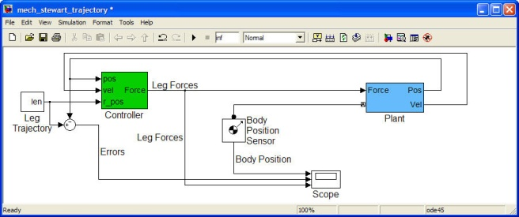
Model-Based Design- Describe the system dynamics
Model-Based Design uses block diagrams to mathematically model the system behavior.
DESIGN
Electrical
Components
Control
Algorithms
You design the way the system should perform.
Embedded
Software
Mechanical
Components
Notes:
With Model-Based Design you combine all these components – mechanical, electrical, control, and software.
[Advance]
in a system-level model of your process or machine.
So the key to Model-Based Design is that you start with a block diagram that mathematically models the system behavior.
By being able to model the system behavior, you can then use dynamic system simulation and try out your ideas. First, you gain an understanding of the overall system that you
are building early in the design. And with this, you can try out different design alternatives, and do initial what-if studies the would be too risky to test directly on the system.

Slide 15
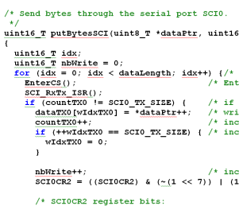
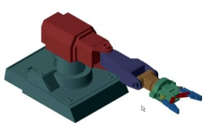
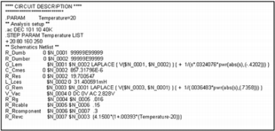
Model-Based Design- Design and test using simulation
RESEARCH
REQUIREMENTS
Requirements are linked to the model.
DESIGN
Environmental Models
Detail is added from specific domains to refine the model.
Mechanical
Electrical
Control Algorithms
Intellectual property and engineering data are reused from existing designs and CAE tools, such as CAD, FEA, and SPICE models.
Supervisory Logic
Testing control algorithms against requirements is done by simulating the model.
Notes:
For engineers, block diagrams are easier to understand than text – because they are visual.
[Advance]
In essence, a block diagram complements the text requirements to communicate design intent.
Actually you can take the text requirements that you have and electronically connect them to your model to show which part of the model implements which requirement.
[ Advance]
This model is elaborated to include all the different elements of the design and operating conditions in one environment.
[ Advance]
You can reuse existing intellectual property and engineering data from existing designs and tools that you use, such as CAD, FEA, and SPICE.
[ Advance]
The model is not only a graphical representation of your design, but it can also simulate.
Therefore we say that the model serves as an executable specification.
So the fact that the model is visual, easy to understand and executable, removes the ambiguity from interpreting the text requirements.
We can start testing the design and requirements through simulation of this system model - very early in the process.
And we can then rapidly iterate on the design, continuously testing and ensuring that we are meeting our requirements and that our requirements are correct.
All the work that you spend in building and developing these models is not wasted because you reuse this model or components of this model for real-time testing.

Slide 16
Model-Based Design- Test and validate in real-time
RESEARCH
REQUIREMENTS
Automatically generate code from the simulation model for real-time testing of the control algorithms.
DESIGN
Environmental Models
Automatically generate code from the simulation model for real-time system simulation of hardware for testing the real microcontroller, FPGA, or PLC
Mechanical
Electrical
Control Algorithms
Supervisory Logic
REAL-TIME TESTING
C, C++
VHDL, Verilog
Structured Text
MCU
DSP
FPGA
ASIC
PLC
Notes:
You can automatically generate code for the control algorithm and test that control out in real-time against some prototype hardware that you have.
[Advance]
Additionally, if you do not have all your hardware available at once, you can simulate aspects of your plant system as well, by generating code for those components.
This testing, of course, continues to check that requirements are being met. You reuse the tests that you have already established for the model, and you can continue to rapidly iterate on your design.

Slide 17
Model-Based Design- Implement embedded software
RESEARCH
REQUIREMENTS
Automatically generate code from the simulation model for real-time testing of the control algorithms.
DESIGN
Environmental Models
Automatically generate code from the simulation model for real-time system simulation of hardware for testing the real microcontroller, FPGA, or PLC
Mechanical
Electrical
Control Algorithms
Supervisory Logic
TEST & VERIFICATION
Automatically generate code from the simulation model for implementing directly on production targets:
Microcontrollers
FPGAs
PLC IDEs
IMPLEMENTATION
C, C++
VHDL, Verilog
Structured Text
MCU
DSP
FPGA
ASIC
PLC
INTEGRATION
Notes:
You can automatically generate code for the control algorithm and test that control out in real-time against some prototype hardware that you have.
[Advance]
Additionally, if you do not have all your hardware available at once, you can simulate aspects of your plant system as well, by generating code for those components.
This testing, of course, continues to check that requirements are being met. You reuse the tests that you have already established for the model, and you can continue to rapidly iterate on your design.

Slide 18

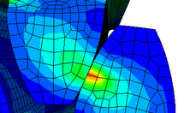
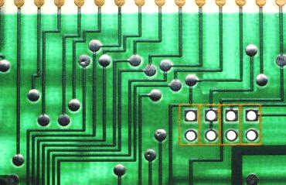
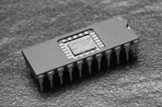
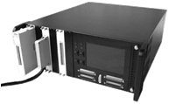
Model-Based Design Process System and Component Level Design
REQUIREMENTS
System-level simulation refines requirements for component design
DESIGN
SYSTEM LEVEL DESIGN
COMPONENT DESIGN
Control
Mechanical
Electrical
JMAG
SABER
SPICE
TEST & VERIFICATION
Co-simulation can be used as a verification step
IMPLEMENTATION
Embedded Software
HIL System
Results from detailed simulation refine system-level simulation for use in rest of design process
INTEGRATION AND TEST
Notes:
Blue arrow from “Component Design” to “System Level Design” includes:
Parameter estimation based on simulation results
Mode export from FEA
Reduced order modeling

Slide 19
Agenda
Overview of Aircraft Power Network Model
Model Based Design
Requirements Traceability
Transformer Rectifier Unit
Logic and Controls
SimElectronics vs SimPowerSystems

Slide 21
Agenda
Overview of Aircraft Power Network Model
Model Based Design
Requirements Traceability
Transformer Rectifier Unit
Logic and Controls
SimElectronics vs SimPowerSystems

Slide 23
Agenda
Overview of Aircraft Power Network Model
Model Based Design
Requirements Traceability
Transformer Rectifier Unit
Logic and Controls
SimElectronics vs SimPowerSystems

Slide 25
Agenda
Overview of Aircraft Power Network Model
Model Based Design
Requirements Traceability
Transformer Rectifier Unit
Logic and Controls
SimElectronics vs SimPowerSystems

Slide 26
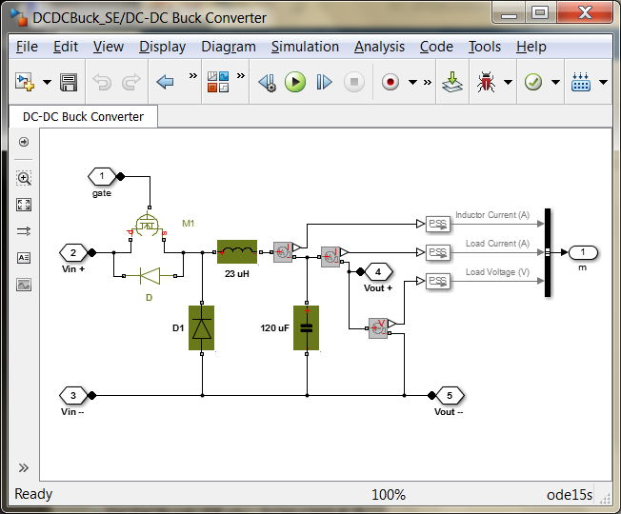
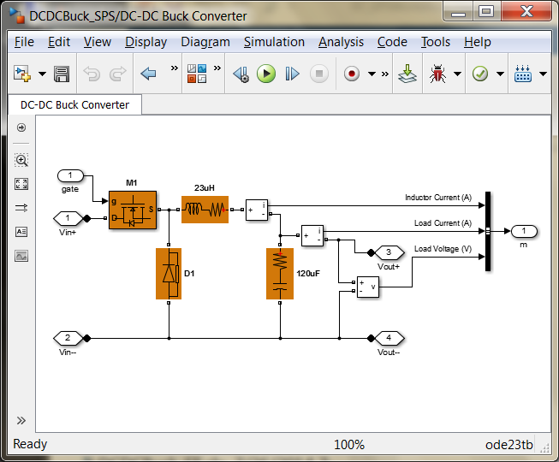
SimElectronics or SimPowerSystems?
SimPowerSystems
Piecewise linear systems solution
Multiphase bridges and pulse generators
Detailed and average voltage models
Transient and harmonic analysis
Faster simulation
SimElectronics
Simultaneous nonlinear equations solution
SPICE level switching device models
Include switching losses
Include parasitic current effects
Include temperature effects
Higher fidelity simulation
>> se_dcdcbuckconverter
>> sps_dcdcbuckconverter

Slide 27
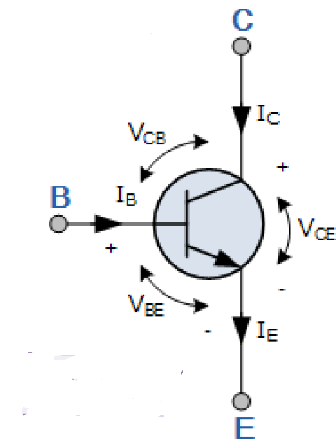
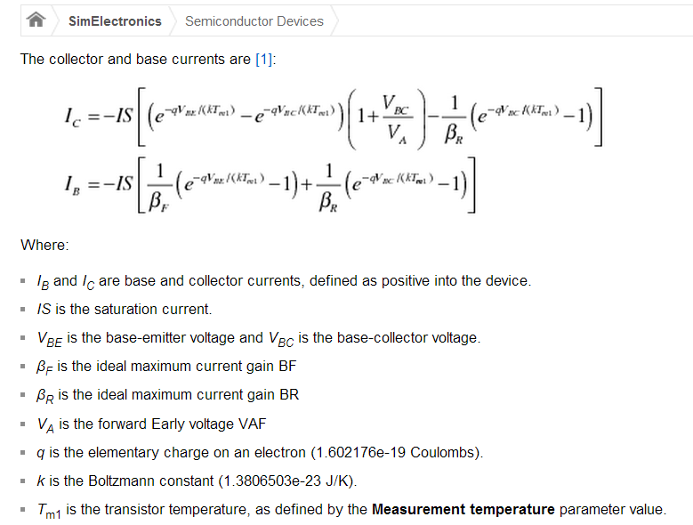
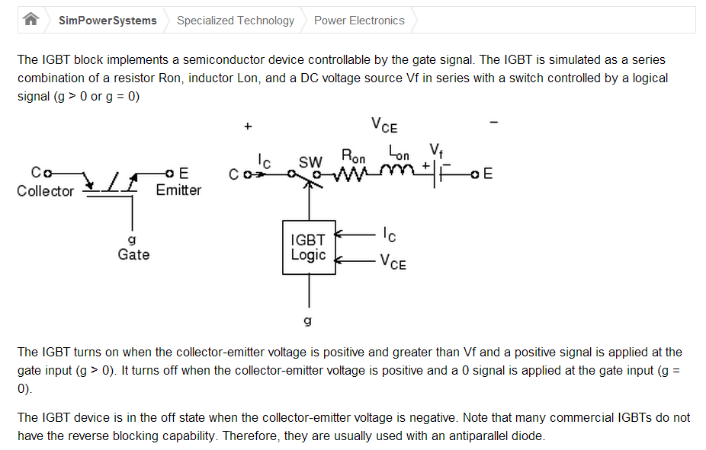


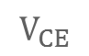
SimElectronics or SimPowerSystems?
SimElectronics
SimPowerSystems
$$V_{BE}$$
$$I_{CE}$$
$$V_{CE}$$

Slide 28
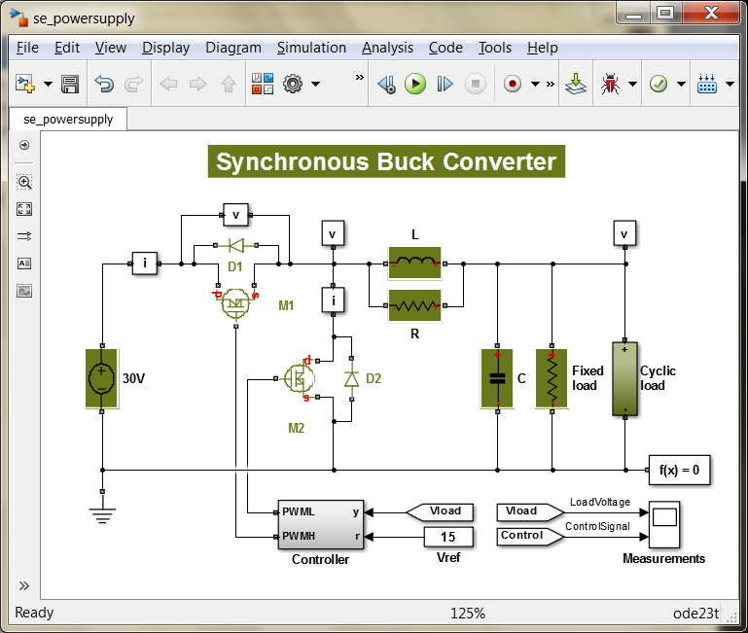
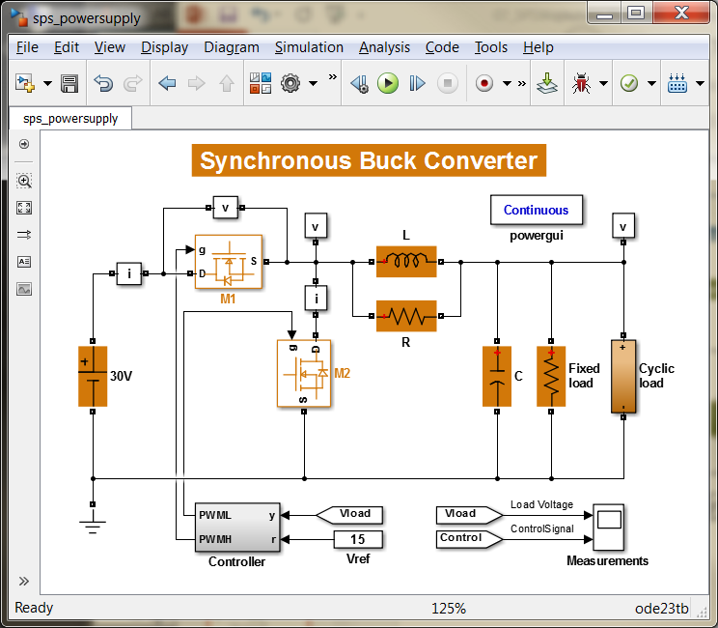
SimElectronics or SimPowerSystems?
SimElectronics
SimPowerSystems
>> edit compare_powersupply

Slide 29
Key Messages
SimPowerSystems can do that stuff you want to do
Circuit Analysis
THD
Logic, Source Selection
Protection: over/under voltage, phase imbalance
Controls
Verification and Validation
There’s a lot more for more in depth discussions
Watch this webinar
mathworks.com – webinars – SimPowerSystems
Aircraft Power Network Development with Model Based Design

Slide 30
Backup

Slide 31
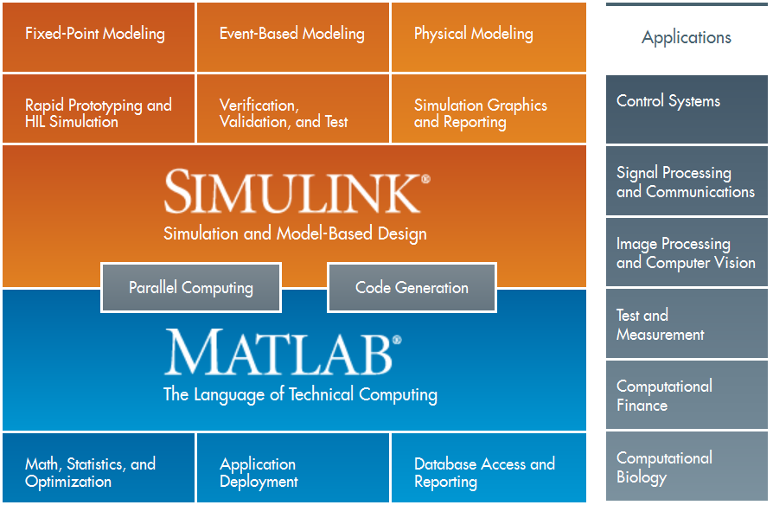
MathWorks Product Overview

Slide 32
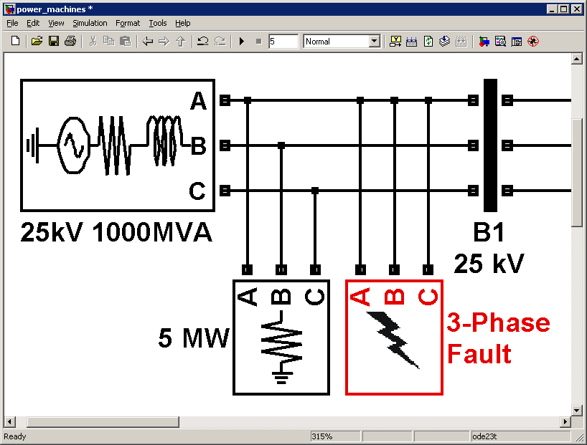
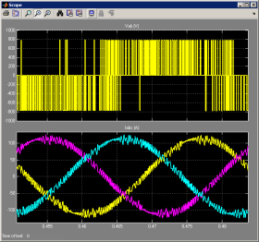
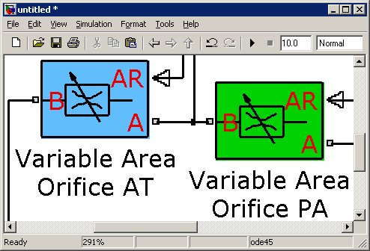
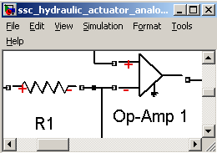
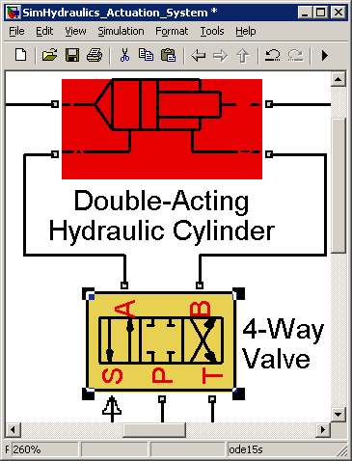
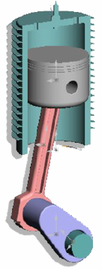
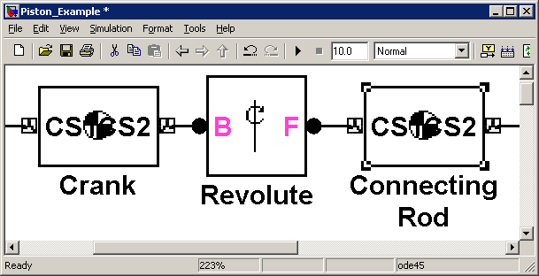
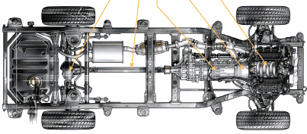
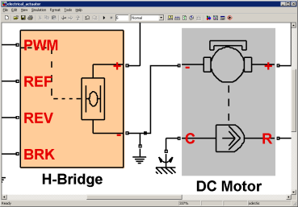
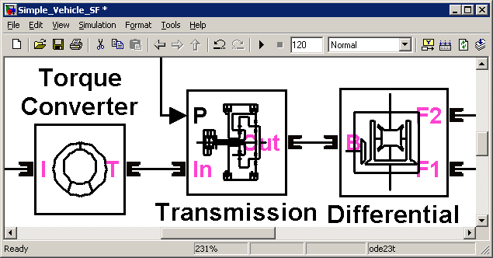
Physical Modeling in Simulink®
SimPowerSystems™
SimHydraulics®
Simscape™
Multi-domain physical systems
SimMechanics™
SimDriveline™
SimElectronics™
Electrical power systems
Fluid power and control
Mechanical dynamics (3-D)
Drivetrain systems (1-D)
Electromechanical and electronic systems

